Slide 1
Building R-packages – Testing
Raphael Hartmann
raphael.hartmann@staff.uni-marburg.de

Slide 2
Motivation
You will probably forget what tests were necessary and which of these you already did
Writing code for testing will lead to
Fewer bugs
Better code structure
Easier restarts
Robust code

Slide 3
Learning objective
What tools to use for testing?
How to automate testing?
How to add testing to your workflow?

Slide 4

Package testthat 3rd edition
First step:
usethis::use_testthat(3)
This will:
Create the subfolder tests/testthat
Add testthat to Suggests in the DESCRIPTION file
Create the file tests/testthat.R, which is responsible for running all your tests when R CMD check is used.

Slide 5

Workflow
Repeat the following until you are satisfied:
Edit an R file (code or tests)
Test your package with devtools::test() (or press Ctrl/Cmd+Shift+T)

Slide 6
Running tests
Running devtools::test() will give you an output like:
Expectation : ...........
rv : ...
Variance : ....123.45.
where each dot represents a passed test and each number a failed test
For each failed test you will get more details:
1. Failure(@test-variance.R#22): Variance correct for discrete uniform rvs ----- VAR(dunif(0, 10)) not equal to var_dunif(0, 10) Mean relative difference: 3

Slide 7
Example of a test file
library(stringr)
context("String length")
test_that("str_length is number of characters", {
expect_equal(str_length("a"), 1)
expect_equal(str_length("ab"), 2)
expect_equal(str_length("abc"), 3)
})
test_that("str_length of factor is length of level", {
expect_equal(str_length(factor("a")), 1)
expect_equal(str_length(factor("ab")), 2)
expect_equal(str_length(factor("abc")), 3)
})

Slide 8
Test file structure
test_XYZ.R: A test file with tests that share the same context, where XYZ stand for some name you want to give. It typically consists of:
Multiple test_that(desc, code) calls: a bundle of tests that are related. They consist of:
desc: A description of what the tests should do. This description should finish the sentence „Test that …“
code: Multiple Expectations; the atom of testing. They always start with expect_ and end with equal(), error(), warning(), message(), etc. (e.g., expect_equal()). All these sub-tests should be closely related

Slide 9
Expectations
Most of the expect_ functions have two arguments
The actual result
The expected result
If the results do not match an error is thrown
The functions can be called interactively

Slide 10
Expectations
Equality:
Two types of equality:
equal (up to an error of 1.0e-7):
expect_equal(10, 10 + 1e-7) # no error
identical (exactly equal):
expect_identical(10, 10 + 1e-7) # error

Slide 11
Expectations
Matches:
Match a character expression against a regular expression:
Example:
expect_match("Testing is fun!", "Testing") # no error
i.e., is the expression „Testing“ included in „Testing is fun!“
The first argument can also be a vector of characters
you can specify whether the expression in the second argument must be in all elements of the vector by an additional argument all = TRUE
Example:
expect_match(c("bla", "bli"), "bla", all = TRUE) # error
Notes:
Internally grepl is used

Slide 12
Expectations
Output, Message, Warning, and Error
Four variations of matches
Difference to matches: You can answer two questions:
Does the output/message/warning/error contain a certain expression?
expect_warning(log(-1), "NaNs produced") # no error
Do you expect an output/message/warning/error?
expect_warning(log(1/0)) # error because log(1/0) = Inf <- no warning
But it is advised to be specific and only use the first type of question
Notes:
Four variations of expect_match

Slide 13
Expectations
Type, S3-class, S4-class:
Checks for inheritance:
expect_type(data.frame(a=c(1,2)), "list") # no error
expect_s3_class(data.frame(a=c(1,2)), "data.frame") # no error
expect_s4_class(data.frame(a=c(1,2)), "list") # error since no S4-object
i.e., is your object of the specified type ("list"), S3-class ("data.frame"), or S4-class

Slide 14
Expectations
True and False:
Checking whether an expression is true or false
expect_true(2 < 4) # no error
expect_false(2 < 4) # error
Typically only useful when other expectation functions cannot be used

Slide 15
More information on testthat
For more information see:
https://testthat.r-lib.org/articles/

Slide 16
Alternatives
Alternative packages are tinytest and RUnit
Advantage of tinytest and RUnit:
less dependencies than in testthat,
i.e., less Imports or Suggests in DESCRIPTION file of these packages compared to testthat
Disadvantage:
less comfort
i.e., there are more functions in testthat
Why do dependencies matter?: https://www.tinyverse.org/

Slide 17

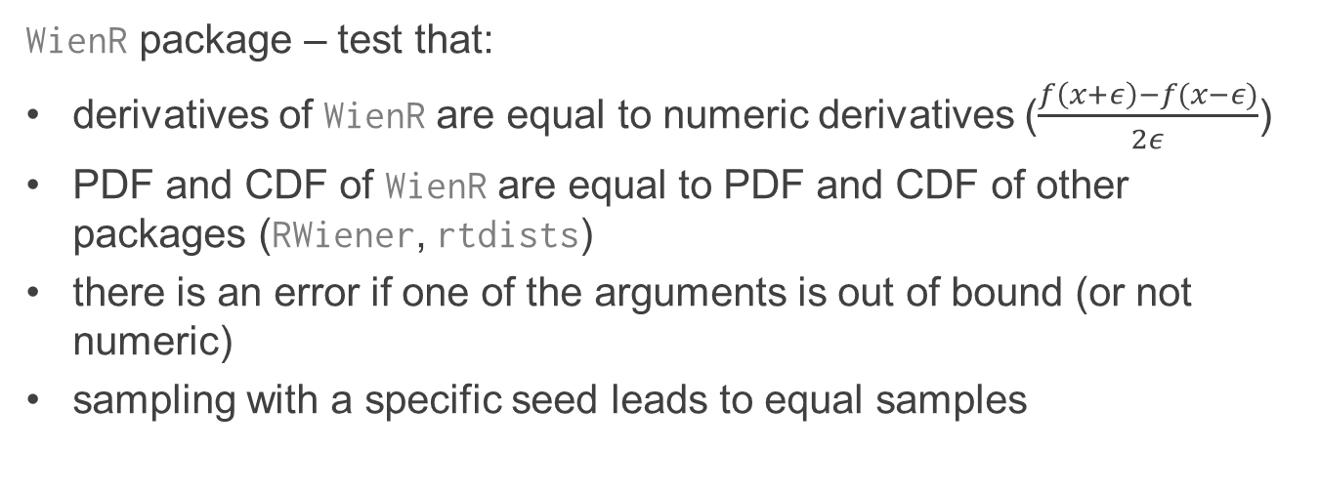
Exercise
10
WienR package – test that:
derivatives of WienR are equal to numeric derivatives ($\frac{f\left(x+ε\right)−f(x−ε)}{2ε}$)
PDF and CDF of WienR are equal to PDF and CDF of other packages (RWiener, rtdists)
there is an error if one of the arguments is out of bound (or not numeric)
sampling with a specific seed leads to equal samples

